Slide 1
Forged Automotive Components Market Outlook,
2025-2032
Drug Class Share, 2025
CAGR 2025-2032
5.0%
Historical Growth
Immunotherapy
48.6%
4.3%
US$ 70.7 Bn
US$ 50.3 Bn
Route of Administration Share, 2025
US$
525.5
Mn
Oral
70.2%
2019
2025
2032

Slide 2
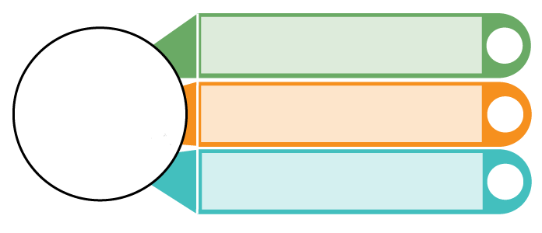
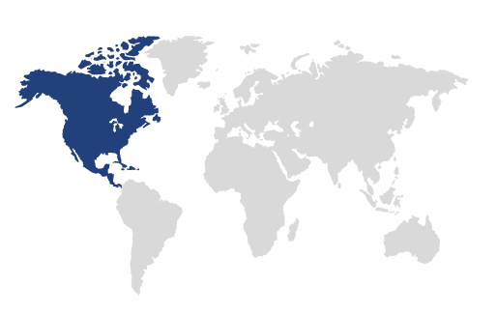
Cutaneous Fibrosis Treatment Market Insights and
Key Trends
North America to hold 36.7% of the 2024 market, driven by fibrosis cases, R&D, and healthcare.
Leading Category
Immunotherapy to grow at 7.5% CAGR (2019-2024) due to efficacy, biologics demand, and adoption.
Fastest Growth
Advancements in drug delivery enhancing efficacy and patient compliance
Key Trends
Key Market Players
Novartis AG, Pfizer, Sanofi, Boehringer Ingelheim International GmbH, Teva Pharmaceuticals, etc.

